Slide 1
A Q-Learning Approach to Solve Mixed-Integer Bilevel Linear Programming Problems
Samuel Rodríguez González
University of Oklahoma
March 2022
Norman, OK

Slide 2
Outline
Motivation: Bilevel Optimization
Reinforcement Learning: Reinforcement Learning & Q-learning
Methodology
Results
Future Work
References

Slide 3
Outline
Motivation: Bilevel Optimization
Reinforcement Learning: Reinforcement Learning & Q-learning
Methodology
Results
Future Work
References

Slide 4

Motivation: Bilevel Optimization
https://www.britannica.com/topic/stock-exchange-finance
Realistic decision problems are affected
by uncertainty and by the actions of others

Slide 5
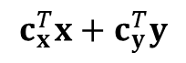
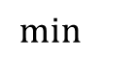
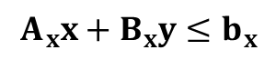

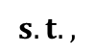
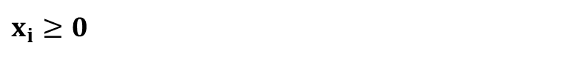
Motivation: Bilevel Optimization
$$\min{}$$
$$c_{x}^{T}x+c_{y}^{T}y$$
$$s.t.,$$
$$A_{x}x+B_{x}y≤b_{x}$$
$y=argmin_{y´}\{d_{y}^{T}y´ : B_{y}y´+A_{y}x≤b_{y}, {y´}_{j}∈ℤ,{y´}_{i}≥0$}
$x_{i}≥0$
$$y_{i}≥0$$
Hoang et al.(1993)
Sinha, Malo, & Deb (2017)

Slide 6




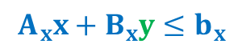



Motivation: Bilevel Optimization
$$\min{}$$
$$c_{x}^{T}x+c_{y}^{T}y$$
$$s.t.,$$
$$Leader$$
$$A_{x}x+B_{x}y≤b_{x}$$
$y=argmin_{y´}\{d_{y}^{T}y´ : B_{y}y´+A_{y}x≤b_{y}, {y´}_{j}∈ℤ,{y´}_{i}≥0$}
$$Follower$$
$x_{i}≥0$
$$y_{i}≥0$$
Hoang et al.(1993)
Sinha, Malo, & Deb (2017)

Slide 7



Motivation: Bilevel Optimization
$$\min{}$$
Employees bonus $- Employees productivity$
$$s.t.,$$
$$Leader$$
$$\text{Employees} \text{bonus}≤Budget$$
$$Follower$$
$$Employees productivity=argmin \{Employees productivity:$$
$Employees productivity≥$ Employees bonus}

Slide 8
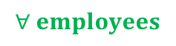

Motivation: Bilevel Optimization
$$\min{}$$
Employees bonus $- Employees productivity$
$$s.t.,$$
$$Leader$$
$$\text{Employees} \text{bonus}≤Budget$$
$$Followers$$
$$Employees productivity=argmin \{Employees productivity:$$
$Employees productivity≥$ Employees bonus}
$$∀ employees$$

Slide 9
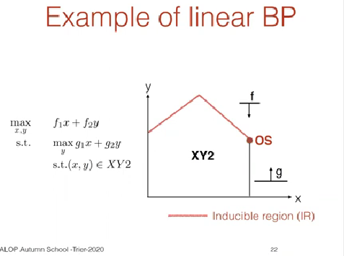
Motivation: Bilevel Optimization
https://www.youtube.com/watch?v=hTDrSjBtKLc&ab_channel=ALOPTrierUniversity

Slide 10
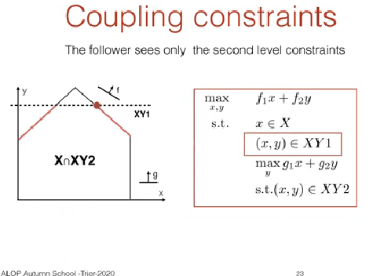
Motivation: Bilevel Optimization
https://www.youtube.com/watch?v=hTDrSjBtKLc&ab_channel=ALOPTrierUniversity

Slide 11
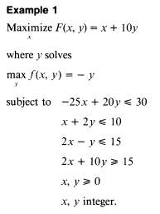
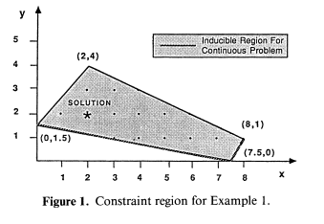
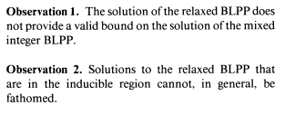
Motivation: Bilevel Optimization
Bard (1990)

Slide 12
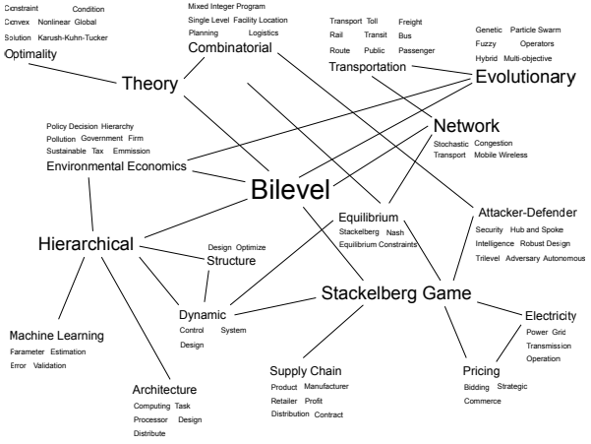
Motivation: Bilevel Optimization
Sinha, Malo, & Deb (2017)

Slide 13
Motivation: Bilevel Optimization
Sinha, Malo, & Deb (2017)

Slide 14
Example: Time-ahead Pricing of Energy Supply (Bachelor’s)
Electric energy sector:
Price
Generation
Transmission
Distribution
Consumption
Consumption
Optimal energy flux
Energy pricing
Allocation expenditures
Financial Aplications
Purely continuous problem, but nonlinear

Slide 15







Example: Time-ahead Pricing of Energy Supply (Bachelor’s)
Energy distributor
Final consumers
Consumer profiles
Residential sector
Industry sector

Slide 16
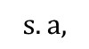
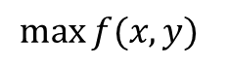
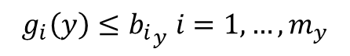
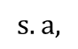
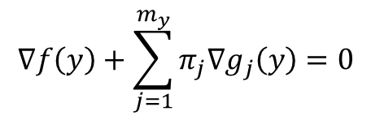
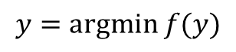

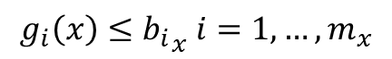
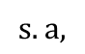
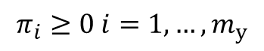
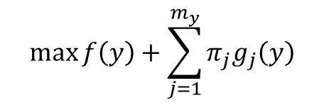
Example: Time-ahead Pricing of Energy Supply (Bachelor’s) Solution Approach
$$\max{f(x,y) }$$
$$s.a,$$
$$Dual de Wolfe$$
$$g_{i}\left(x\right)≤{b_{i}}_{x} i=1,…, m_{x}$$
$$\max{f\left(y\right)+\sum_{j=1}^{m_{y}}{π_{j}g_{j}\left(y\right)}}$$
$$y=argmin f(y)$$
$$s.a,$$
$$s.a,$$
$$g_{i}\left(y\right)≤{b_{i}}_{y} i=1,…, m_{y}$$
$$∇f\left(y\right)+\sum_{j=1}^{m_{y}}{π_{j}∇g_{j}\left(y\right)}=0$$
$$π_{i}≥0 i=1,…,m_{y}$$
$$Wolfe (1960)$$

Slide 17
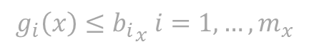
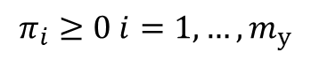
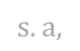
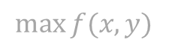
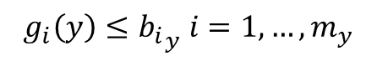
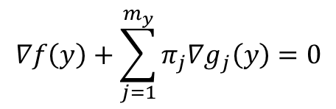
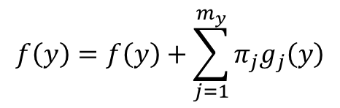
Example: Time-ahead Pricing of Energy Supply (Bachelor’s) Solution Approach
KKT
Primal feasibility
Dual feasibility
Complementry Slackness
$$\max{f(x,y) }$$
$$s.a,$$
$$g_{i}\left(x\right)≤{b_{i}}_{x} i=1,…, m_{x}$$
$$g_{i}\left(y\right)≤{b_{i}}_{y} i=1,…, m_{y}$$
$$∇f\left(y\right)+\sum_{j=1}^{m_{y}}{π_{j}∇g_{j}\left(y\right)}=0$$
$$π_{i}≥0 i=1,…,m_{y}$$
$$f\left(y\right)=f\left(y\right)+\sum_{j=1}^{m_{y}}{π_{j}g_{j}\left(y\right)}$$
$$Wolfe (1960)$$

Slide 18
Example: Time-ahead Pricing of Energy Supply (Bachelor’s) Solution Approach
KKT
Primal feasibility
Dual feasibility
Complementry Slackness
$$\max{f(x,y) }$$
$$s.a,$$
$$g_{i}\left(x\right)≤{b_{i}}_{x} i=1,…, m_{x}$$
$$g_{i}\left(y\right)≤{b_{i}}_{y} i=1,…, m_{y}$$
$$∇f\left(y\right)+\sum_{j=1}^{m_{y}}{π_{j}∇g_{j}\left(y\right)}=0$$
$$π_{i}≥0 i=1,…,m_{y}$$
$$f\left(y\right)=f\left(y\right)+\sum_{j=1}^{m_{y}}{π_{j}g_{j}\left(y\right)}$$
$$Wolfe (1960)$$

Slide 19

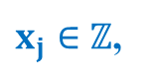
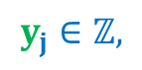

Motivation: Bilevel Optimization
$$\min{}$$
$$c_{x}^{T}x+c_{y}^{T}y$$
$$s.t.,$$
$$Leader$$
$$A_{x}x+B_{x}y≤b_{x}$$
$y=argmin_{y´}\{d_{y}^{T}y´ : B_{y}y´+A_{y}x≤b_{y}, {y´}_{j}∈ℤ,{y´}_{i}≥0$}
$$Follower$$
$x_{j}∈ℤ$,
$x_{i}≥0$
$$y_{i}≥0$$
$$y_{j}∈ℤ,$$
Hoang et al.(1993)
Sinha, Malo, & Deb (2017)

Slide 20
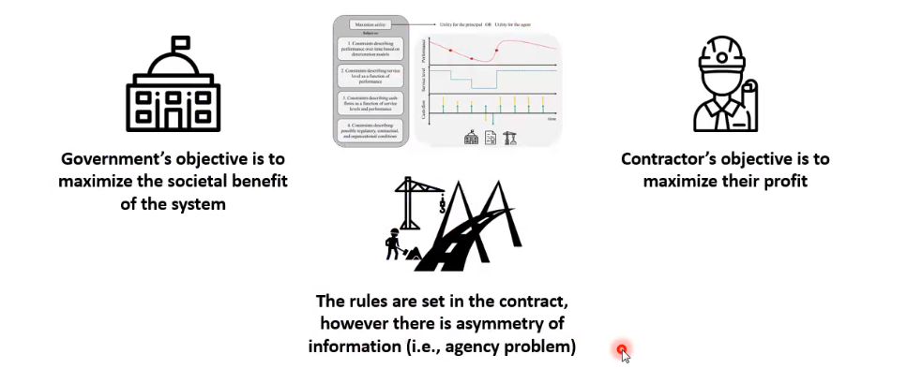
Example: PPPs in infrastructure projects (Master’s)
Public Private Partnerships (PPPs)
Principal
Agent
Pros: Technical expertise
Cons: Principal-Agent (PA) Problem
Jensen & Meckling (1976)
Liu et al. (2017)

Slide 21



Example: PPPs in infrastructure projects (Master’s)
Maximize
Maximize utility
Utility for the principal & Utility for the agent
Subject to:
1. Constraints describing performance over time based on deterioration models
Performance
2. Constraints describing service level as a function of performance
Service level
3. Constraints describing cash-flows as a function of service levels and performance
Cash-flow
4. Constraints describing possible regulatory, contractual, and organizational conditions
time
Gómez et al. (2020)

Slide 22
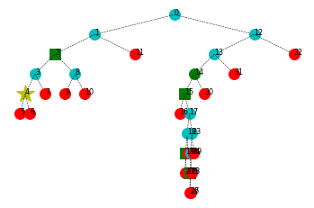
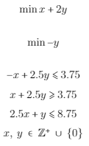
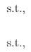
Example: PPPs in infrastructure projects B&B (Master’s)
E.g., Toy example
infeasible
Fractional solution
Bi-level infeasible Integer solution
Bi-level feasible Integer solution
Optimal solution

Slide 23
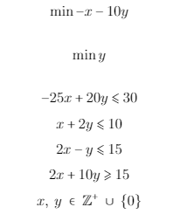
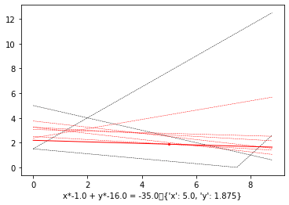
Example: PPPs in infrastructure projects B&C (Master’s)
Conforti et al. (2014)

Slide 24
Outline
Motivation: Bilevel Optimization
Reinforcement Learning: Q-learning
Methodology
Results
Future Work
References

Slide 25

Reinforcement Learning: Q-learning
https://www.novatec-gmbh.de/en/blog/introduction-to-q-learning/
Markov Decision Process (MDP)

Slide 26

Reinforcement Learning: Q-learning
https://www.istockphoto.com/photo/clams-on-the-beach-gm479566204-68089953

Slide 27
Reinforcement Learning: Q-learning
States: Position on the beach at a given hour of the day.
Actions: Move to another position on the beach.
Rewards: Amount of clams found on that position (the sea randomly leaves clams around the different locations at random times).

Slide 28
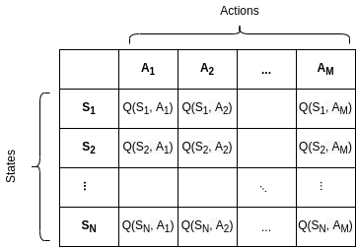
Reinforcement Learning: Q-learning
https://www.baeldung.com/cs/epsilon-greedy-q-learning

Slide 29
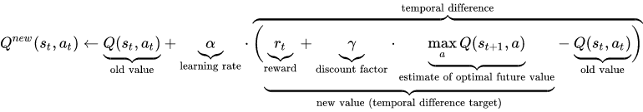
Reinforcement Learning: Q-learning
https://wikimedia.org/api/rest_v1/media/math/render/svg/678cb558a9d59c33ef4810c9618baf34a9577686

Slide 30
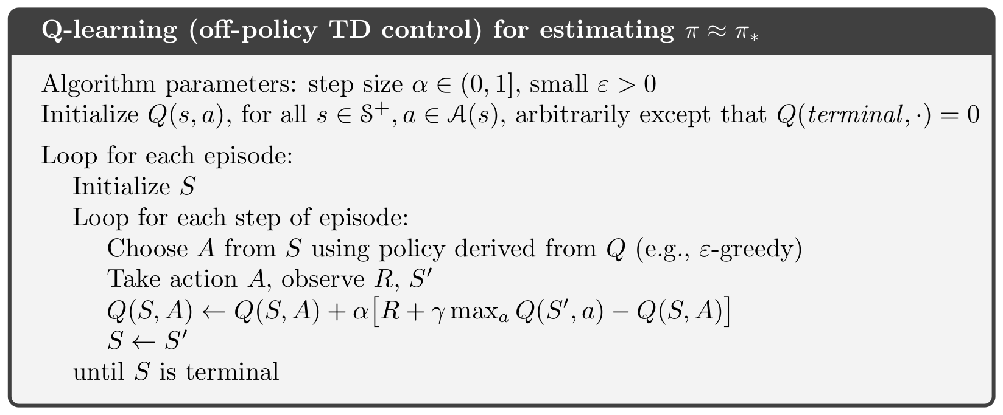
Reinforcement Learning: Q-learning
Sutton & Barto (2018)

Slide 31
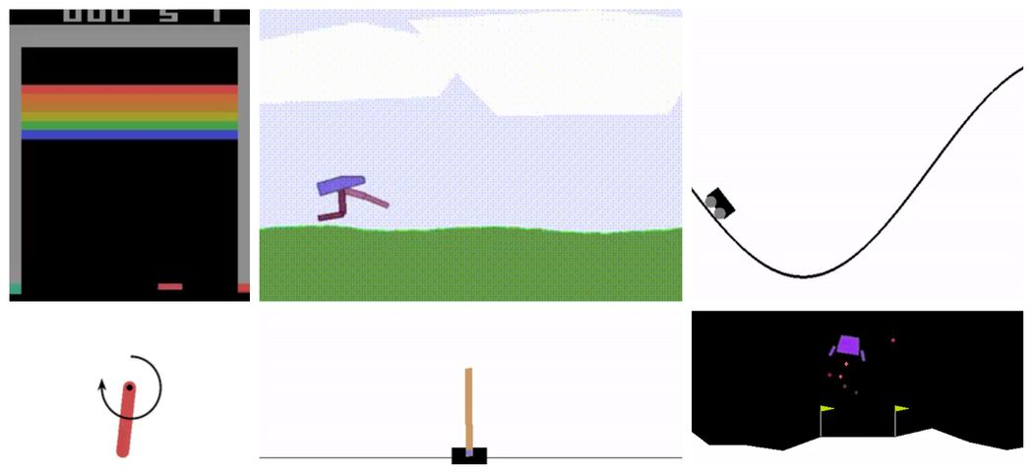
Reinforcement Learning: Q-learning
https://blog.paperspace.com/creating-custom-environments-openai-gym/

Slide 32
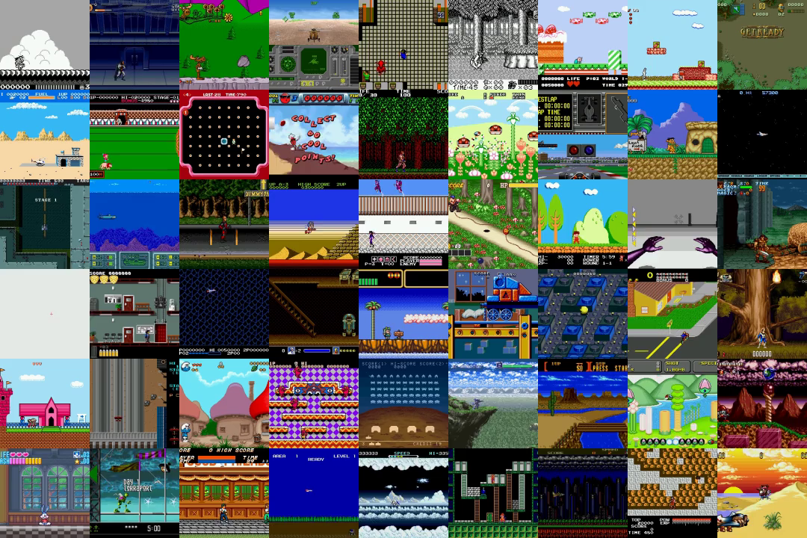
Reinforcement Learning: Q-learning
https://openai.com/blog/gym-retro/

Slide 33
Outline
Motivation: Bilevel Optimization
Reinforcement Learning: Q-learning
Methodology
Results
Future Work
References

Slide 34
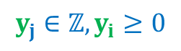
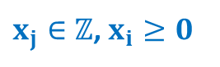
Methodology
$$\min{}$$
$$c_{x}^{T}x+c_{y}^{T}y$$
$$s.t.,$$
$$Leader$$
$$A_{x}x+B_{x}y≤b_{x}$$
$y=argmin\{d_{y}^{T}y´ : B_{y}y´+A_{y}x≤b_{y}, {y´}_{j}∈ℤ,{y´}_{i}≥0$}
$$Follower$$
$x_{j}∈ℤ$, $x_{i}≥0$
$$y_{j}∈ℤ,y_{i}≥0$$
Hoang et al.(1993)
Sinha, Malo, & Deb (2017)

Slide 35
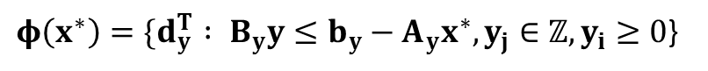
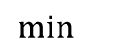
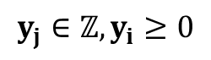
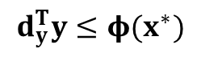
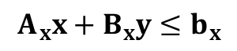


Methodology
$$\min{}$$
$$c_{x}^{T}x+c_{y}^{T}y$$
Value function formulation
$$s.t.,$$
$$A_{x}x+B_{x}y≤b_{x}$$
$$d_{y}^{T}y≤φ(x^{∗})$$
$φ\left(x^{∗}\right)=\{d_{y}^{T} : B_{y}y≤b_{y}−A_{y}x^{∗},y_{j}∈ℤ,y_{i}≥0$}
$x_{j}∈ℤ$, $x_{i}≥0$
$$y_{j}∈ℤ,y_{i}≥0$$
Outrara (1990)

Slide 36






Methodology
$$\min{}$$
$$c_{x}^{T}x+c_{y}^{T}y$$
High Point Relaxation
$$s.t.,$$
$$A_{x}x+B_{x}y≤b_{x}$$
$$d_{y}^{T}y^{∗}≤φ(x^{∗})$$
$${A_{y}x+B}_{y}y≤b_{y}$$
$$d_{y}^{T}y≤φ(x^{∗})$$
Best follower’s response
$φ\left(x^{∗}\right)=\{d_{y}^{T} : B_{y}y≤b_{y}−A_{y}x^{∗},y_{j}∈ℤ,y_{i}≥0$}
$x_{j}∈ℤ$, $x_{i}≥0$
Bi-level feasibility
$$y_{j}∈ℤ,y_{i}≥0$$
Outrara (1990)

Slide 37
Methodology
$$\min{}$$
$$c_{x}^{T}x+c_{y}^{T}y$$
HPR
$$s.t.,$$
$$A_{x}x+B_{x}y≤b_{x}$$
$$d_{y}^{T}y^{∗}≤φ(x^{∗})$$
$${A_{y}x+B}_{y}y≤b_{y}$$
$$d_{y}^{T}y≤φ(x^{∗})$$
Best follower’s response
$φ\left(x^{∗}\right)=\{d_{y}^{T} : B_{y}y≤b_{y}−A_{y}x^{∗},y_{j}∈ℤ,y_{i}≥0$}
$x_{j}∈ℤ$, $x_{i}≥0$
Bi-level feasibility
$$y_{j}∈ℤ,y_{i}≥0$$
Outrara (1990)

Slide 38



Methodology
$$\min{}$$
$$c_{x}^{T}x+c_{y}^{T}y$$
$$\overline{HPR}$$
$$s.t.,$$
$$A_{x}x+B_{x}y≤b_{x}$$
$${A_{y}x+B}_{y}y≤b_{y}$$
$$d_{y}^{T}y≤φ(x^{∗})$$
$φ\left(x^{∗}\right)=\{d_{y}^{T} : B_{y}y≤b_{y}−A_{y}x^{∗},y_{j}∈ℤ,y_{i}≥0$}
$x_{i}≥0$
$$y_{i}≥0$$
Outrara (1990)

Slide 39



y
<
x
Leader: min $2x − 11y$
Follower min $x+3y$

Slide 40
Inducible Region
y
<
x
Leader: min $2x − 11y$
Follower min $x+3y$

Slide 41
Methodology
Transform the MIBLP
into an MDP

Slide 42

Methodology
States: all leader leader variables $x_{i}$ combinations $(x_{i}^{−}≤x_{i}≤x_{i}^{+} ∀ i∈J_{x}$).
Actions: +1, -1 or no change for all leader variables (one at a time).
Rewards: HPR objective function value at the new point $\left(x,y\right)$; if infeasible, penalize.
Transitions are deterministic.

Slide 43

Methodology

Slide 44
Initial s first strategy: randomly get to a simplex vertex and round to the nerest integer
y
<
x

Slide 45
Initial s first strategy: randomly get to a simplex vertex and round to the nerest integer
y
<
x

Slide 46
Initial s second strategy: randomly select an existing solution
y
<
x

Slide 47
Initial s third strategy: randomly select the incumbent
y
<
x

Slide 48
Methodology

Slide 49
Methodology

Slide 50

Methodology
Notes:
Rewards structure

Slide 51
Inducible Region
y
<
x
-1
+1
0

Slide 52
Inducible Region
y
<
x
-1
+1
0
Notes:
Boundaries of the variables

Slide 53
Inducible Region
y
<
penalized
x
Notes:
Penalize infeasibility

Slide 54
Outline
Motivation: Bilevel Optimization
Literature Review: Reinforcement Learning & Q-learning
Methodology
Results
Future Work
References

Slide 55

Results

Slide 56

Results

Slide 57

Results

Slide 58

Results

Slide 59

Results

Slide 60

Results

Slide 61

Results
Branch & Bound
Branch & Cut
vs.
Reinforcement
Learning
Esta foto de Autor desconocido está bajo licencia CC BY-NC

Slide 62
Outline
Motivation: Bilevel Optimization
Literature Review: Reinforcement Learning & Q-learning
Methodology
Results
Future Work
References

Slide 63

Future Work
https://themachinelearners.com/maldicion-dimension-pca/

Slide 64

Future Work
https://medium.com/@vishnuvijayanpv/deep-reinforcement-learning-value-functions-dqn-actor-critic-method-backpropagation-through-83a277d8c38d

Slide 65

Future Work
https://skirt.ugent.be/skirt9/_parallelization.html

Slide 66
Inducible Region
y
<
x

Slide 67
Inducible Region
y
<
Incumbent OF value
x

Slide 68
Future Work
Any ideas are welcome!
☺

Slide 69
Future Work
Reinforcement
Learning
vs.
New approach
(looking for a fancy name)
For another day…
Esta foto de Autor desconocido está bajo licencia CC BY-NC

Slide 70
Outline
Motivation: Bilevel Optimization
Literature Review: Reinforcement Learning & Q-learning
Methodology
Results
Future Work
References

Slide 71
References
Mohamed Alloghani et al.A Systematic Reviewon Supervised and Unsupervised Machine LearningAlgorithms for Data Science. Ed. by Michael W.Berry, Azlinah Mohamed, and Bee Wah Yap. Cham:Springer International Publishing, 2020, pp. 3–21.ISBN: 978-3-030-22475-2.DOI: 10 . 1007 / 978 - 3 -030-22475-21.URL: https://doi.org/10.1007/978-3-030-22475-21
C.P. Andriotis and K.G. Papakonstantinou. “Deepreinforcement learning driven inspection and main-tenance planning under incomplete information andconstraints”. In:Reliability EngineeringSystemSafety212 (2021), p. 107551.ISSN: 0951-8320.DOI: https : / / doi . org / 10 . 1016 / j . ress . 2021 . 107551.URL:https://www.sciencedirect.com/science/article/pii/S095183202100106X
J. F. Bard. “Some properties of the bilevel program-ming problem”. In:Journal of Optimization Theoryand Applications68.2 (Feb. 1991), pp. 371–378.ISSN: 1573-2878.DOI: 10.1007/BF00941574.URL:https://doi.org/10.1007/BF00941574
Jonathan F. Bard and James T. Moore. “A Branchand Bound Algorithm for the Bilevel ProgrammingProblem”. In:SIAM J. Sci. Stat. Comput.11.2(1990), pp. 281–292.ISSN: 0196-5204.DOI: 10 .1137/0911017
Michele Conforti, G ́erard Cornu ́ejols, and GiacomoZambelli. “Equivalence between intersection cutsand the corner polyhedron”. In:Oper. Res. Lett.38.3 (2010), pp. 153–155.ISSN: 01676377.DOI:10.1016/j.orl.2010.02.006.URL: www.elsevier.com/locate/orl
Nariman L. Dehghani, Ashkan B. Jeddi, and Abdol-lah Shafieezadeh. “Intelligent hurricane resilienceenhancement of power distribution systems via deepreinforcement learning”. In:Applied Energy285(2021), p. 116355.ISSN: 0306-2619.DOI: https :/ / doi . org / 10 . 1016 / j . apenergy. 2020 . 116355.URL:https://www.sciencedirect.com/science/article/pii/S0306261920317359
Matteo Fischetti et al. “A New General-PurposeAlgorithm for Mixed-Integer Bilevel Linear Pro-grams”. In:Oper. Res.65.6 (Dec. 2017), pp. 1615–1637.ISSN: 0030-364X.DOI: 10.1287/opre.2017.1650.URL: https://doi.org/10.1287/opre.2017.1650
Jens Kober, J. Andrew Bagnell, and Jan Peters.“Reinforcement learning in robotics: A survey”.In:The International Journal of Robotics Research32.11 (2013), pp. 1238–1274.DOI: 10 . 1177 /0278364913495721. eprint: https://doi.org/10.1177/0278364913495721.URL: https://doi.org/10.1177/0278364913495721
C. D. Kolstad and L. S. Lasdon. “Derivative evalua-tion and computational experience with large bilevelmathematical programs”. In:J. Optim. Theory Appl.65.3 (1990), pp. 485–499.ISSN: 00223239.DOI:10.1007/BF00939562
A. Kov ́acs. “On the Computational Complexity ofTariff Optimization for Demand Response Manage-ment”. In:IEEE Transactions on Power Systems33.3 (May 2018), pp. 3204–3206.DOI: 10 . 1109 /TPWRS.2018.2802198
H. Li, L. Zhang, and Y. Jiao. “Solution for integerlinear bilevel programming problems using orthog-onal genetic algorithm”. In:Journal of Systems En-gineering and Electronics25.3 (2014), pp. 443–451
Yu Liu, Yiming Chen, and Tao Jiang. “Dynamicselective maintenance optimization for multi-statesystems over a finite horizon: A deep reinforcementlearning approach”. In:European Journal of Oper-ational Research283.1 (2020), pp. 166–181.ISSN:0377-2217.DOI: https : / / doi . org / 10 . 1016 / j . ejor.2019.10.049.URL: https://www.sciencedirect.com/science/article/pii/S0377221719309014

Slide 72
References
Ngo Van Long and Gerhard Sorger. “A dynamicprincipal-agent problem as a feedback Stackelbergdifferential game”. In:Central European Journal ofOperations Research18 (2010), pp. 491–509
Volodymyr Mnih et al. “Human-level controlthrough deep reinforcement learning”. In:Nature518 (2015), pp. 529–533
J. V. Outrata. “On the numerical solution of aclass of Stackelberg problems”. In:Zeitschrift f ̈urOperations Research34.4 (July 1990), pp. 255–277.
17ISSN: 1432-5217.DOI: 10.1007/BF01416737.URL:https://doi.org/10.1007/BF01416737
Warren B. Powell. “A unified framework forstochastic optimization”. In:European Journal ofOperational Research275.3 (2019), pp. 795–821.ISSN: 0377-2217.DOI: https : / / doi . org / 10 . 1016 / j .ejor.2018.07.014.URL: https://www.sciencedirect.com/science/article/pii/S0377221718306192
Florian Pusse and Matthias Klusch. “Hybrid On-line POMDP Planning and Deep ReinforcementLearning for Safer Self-Driving Cars”. In: (2019),pp. 1013–1020.DOI: 10.1109/IVS.2019.8814125
Ankur Sinha, Pekka Malo, and Kalyanmoy Deb.“A Review on Bilevel Optimization: From Classicalto Evolutionary Approaches and Applications”. In:IEEE Transactions on Evolutionary Computation22(2017), pp. 276–295
Richard S. Sutton and Andrew G. Barto.Reinforce-ment Learning: An Introduction. Cambridge, MA,USA: A Bradford Book, 2018.ISBN: 0262039249
Yen Tang, Jean-Philippe P. Richard, and J. ColeSmith. “A Class of Algorithms for Mixed-IntegerBilevel Min—Max Optimization”. In:J. of GlobalOptimization66.2 (Oct. 2016), pp. 225–262.ISSN:0925-5001.DOI: 10 . 1007 / s10898 - 015 - 0274 - 7.URL: https://doi.org/10.1007/s10898-015-0274-7
Hoang Tuy, Athanasios Migdalas, and PeterV ̈arbrand. “A global optimization approach for thelinear two-level program”. In:J. Glob. Optim.3.1(1993), pp. 1–23.ISSN: 09255001.DOI: 10.1007/BF01100237.URL: https : / / link - springer - com .ezproxy . uniandes . edu . co : 8443 / content / pdf / 10 .1007%7B%5C%%7D2FBF01100237.pdf
Christopher Watkins. “Learning From Delayed Re-wards”. In: (Jan. 1989)
Zhen-chen Zhou, Zhou Wu, and Tao Jin. “Deepreinforcement learning framework for resilienceenhancement of distribution systems under ex-treme weather events”. In:International Journalof Electrical Power Energy Systems128 (2021),p. 106676.ISSN: 0142-0615.DOI: https : / / doi .org / 10 . 1016 / j . ijepes . 2020 . 106676.URL: https :/ / www . sciencedirect . com / science / article / pii /S0142061520342216.Instance problems:

Slide 74

Bi-level MIP model of PPPs: sets and parameters

Slide 75

Bi-level MIP model of PPPs: variables

Slide 76






Bi-level MIP model of PPPs: leader’s problem
$$s.t.,$$
$ϕ\left({Inspection}^{∗}\right):=$ $\min{Agent′s Utility }$
Notes:
Minimizar gastos

Slide 77
Bi-level MIP model of PPPs: constraints
$$Constraint blocks to model performance (and service levels)$$

Slide 78






Bi-level MIP model of PPPs: constraints
$$Constraint block to keep track of finance$$

Slide 79
Bi-level MIP model of PPPs: constraints
$$Performance and profit thresholds (and domain of the variables)$$
Domain of the variables

Slide 80




Bi-level MIP model of PPPs: Principal-Agent relationship
Principal’s
penalty/reward policy
Principal’s
benefit
$$Agent′s cashflow$$
$${Agent}^{′}s maintenance$$
$$decisions$$
Notes:
La relación entre los dos problemas es que el principal escoge el tamaño de las multas/incentivos y estas se reflejan en las restricciones del agente

